Slide 1
PowerPoint Prototype
Config ref: SE.GP14.UIPresentation
Author: JAS130

Slide 2
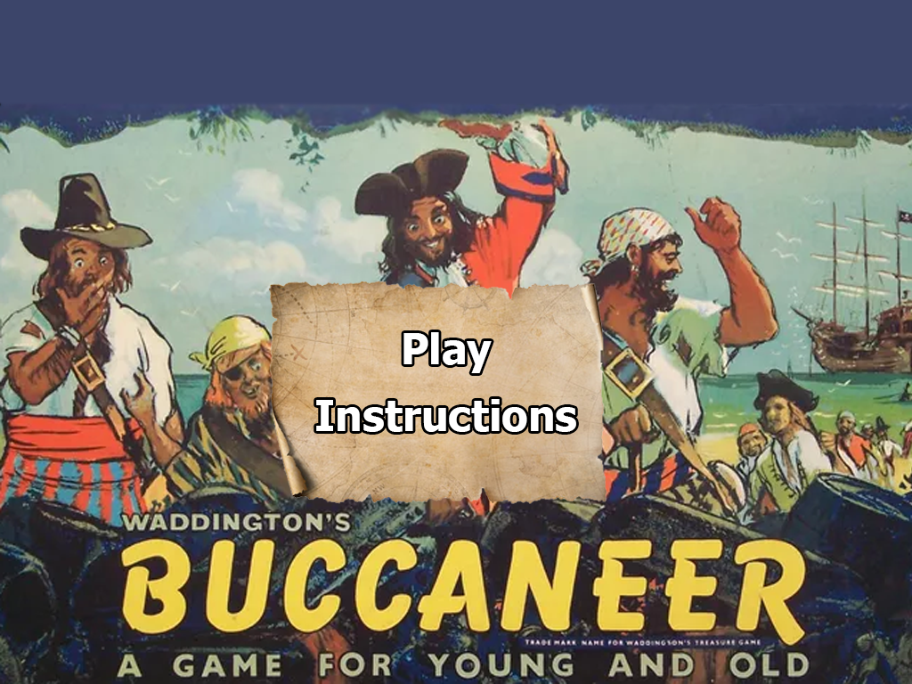
Use case 1.1
Task 1: Launch game
Action: Click on the play button
Result: The user will be taken to a screen to enter the player’s names

Slide 3
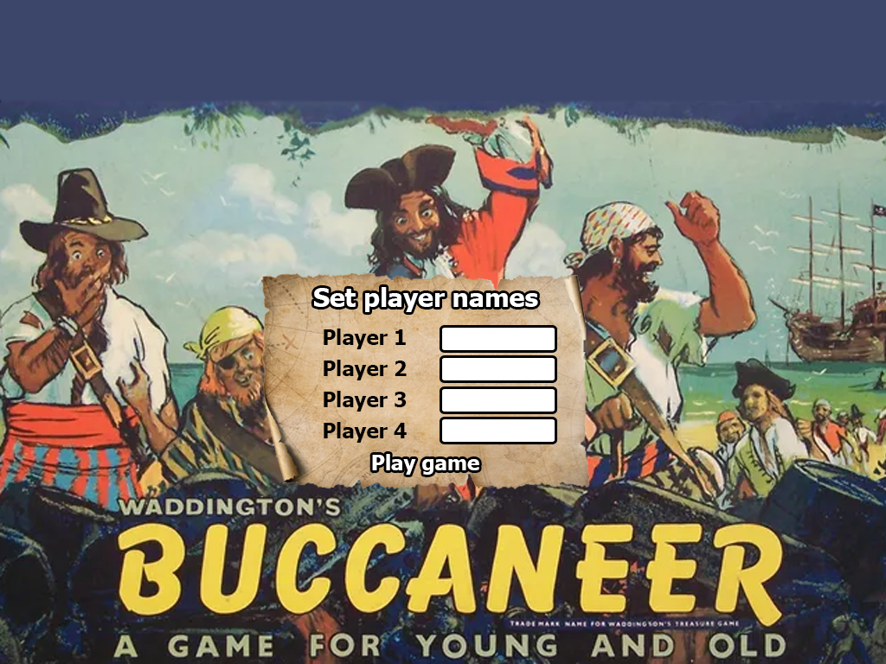
Use case 1.1
Task 1: Launch game
Action: Enter the player’s names and presses the play game button
Result: The game launches to the board

Slide 4
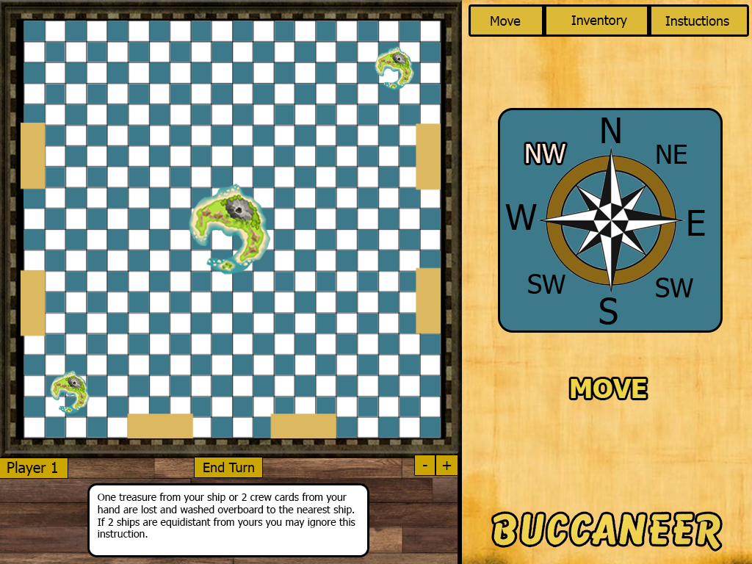

Use case 1.1
Task 1: Launch game
Final State: The game board is displayed and the game begins
3
N
4
NW
NE
W
E
2
SW
SE
S
1

Slide 5
Use case 1.2
Task 2: Display Instructions
Action: Click on the instructions button
Result: A list of instructions are displayed

Slide 6
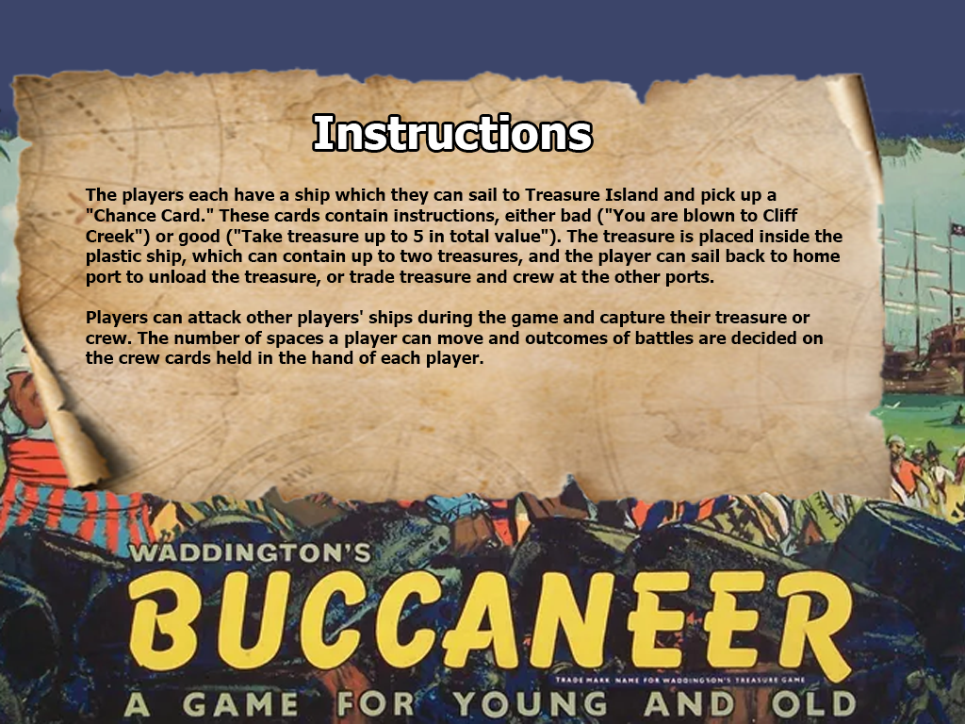
Use case 1.2
Task 2: Display Instructions
Final State: The instructions are shown
<-

Slide 7
Use case 2.1.2
Task 3: Open inventory
Action: Click Inventory tab
Result: Shows Inventory
3
N
4
NW
NE
W
E
2
SW
SE
S
1

Slide 8
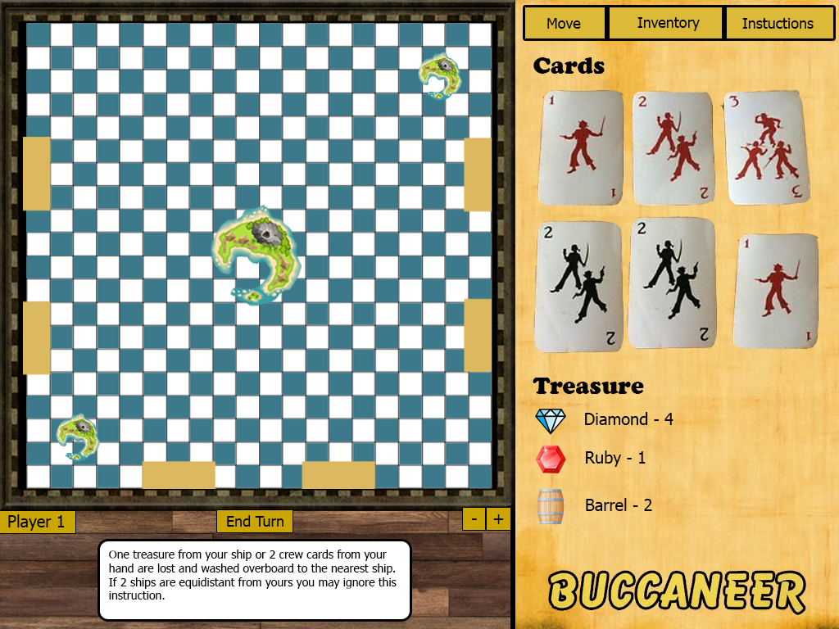




Use case 2.1.2
Task 3: Open inventory
Final State: Displays the cards and treasure a player has collected
3
4
2
1

Slide 9
Use case 2.1.3
Task 4: Open Instructions
Action: Click Instructions tab
Result: Shows Instructions
3
4
E
2
1

Slide 10
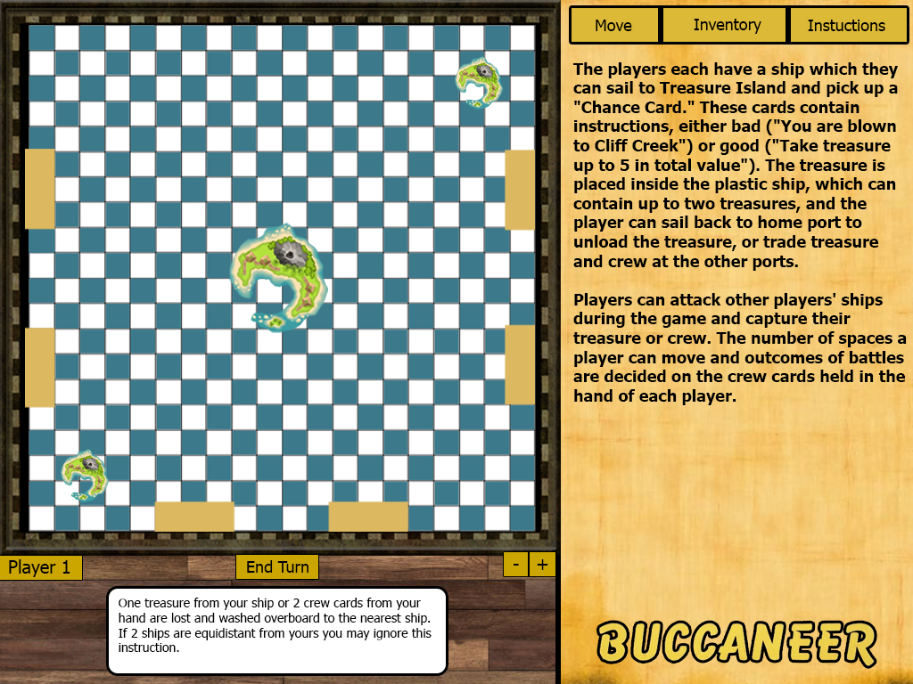
Use case 2.1.3
Task 4: Open Instructions
Final State: Displays instructions
3
4
2
1

Slide 11
Use case 2.1.1
Task 5: Open Movement controls
Action: Click Move tab
Result: Shows Movement
3
4
2
1

Slide 12
Use case 2.1.1
Task 5: Open movement controls
Final State: Shows the controls for moving the ship and rotating it
3
N
4
NW
NE
W
E
2
SW
SE
S
1

Slide 13
Use case 2.3
Task 6: Pull a chance card
Action: Click move when facing treasure island
Result: Ship will move towards the island
3
N
N
4
NE
NW
NE
NW
W
W
E
E
2
SW
SW
SE
SE
S
S
1

Slide 14
Use case 2.3
Task 6: Pull a chance card
Final State: The player is at treasure island and receives a chance card
3
N
4
NW
NE
W
E
2
1
SW
SE
S

Slide 15
Use case 2.4
Task 7: Pull a tradable card
Action: Click move when facing treasure island
Result: Ship will move towards the island
3
N
N
4
NE
NW
NE
NW
W
W
E
E
2
SW
SW
SE
SE
S
S
1

Slide 16
Use case 2.4
Task 7: Pull a tradable card
Final State: The player is at treasure island and receives a tradable card
3
N
4
NW
NE
W
E
2
1
SW
SE
S
Pieces of eight (Keep this card). This card may be traded for crew or treasure up to value 4 in any port you visit.

Slide 17
Use case 2.5
Task 8: Pull an action card
Action: Click move when facing treasure island
Result: Ship will move towards the island
3
N
N
4
NE
NW
NE
NW
W
W
E
E
2
SW
SW
SE
SE
S
S
1

Slide 18
Use case 2.5
Task 8: Pull an action card
Action: Turn around to face pirate island
Result: Ship will rotate
3
N
4
NW
NE
W
E
2
1
SW
SE
S
Kidd's chart (Keep this card). You may sail to the far side of Pirate Island, on to the square marked with an anchor. Land this chart there, and take treasure up to 7 in total value from Treasure Island.

Slide 19
Use case 2.5
Task 8: Pull an action card
Action: Head towards pirate island
Result: Ship will move towards the island
3
N
4
NW
NE
W
E
2
1
SW
SE
S

Slide 20
Use case 2.5
Task 8: Pull an action card
Action: Move to the cove
Result: Ship will move
3
N
4
NW
NE
W
E
2
SW
SE
S
1

Slide 21
Use case 2.5
Task 8: Pull an action card
Final State: The ship has reached the cove and has received treasure
3
N
4
NW
NE
W
E
2
SW
SE
S
1
You receive treasure valuing 7

Slide 22
Use case 2.6
Task 9: Trade at ports
Action: Move to a port
Result: Brings up a trading menu
3
N
4
NW
NE
W
E
2
SW
SE
1
S

Slide 23

Use case 2.6
Task 9: Trade at ports
Final State: A menu appears for the player to trade from
3
London
Items for trade
Barrel - 3
4
E
2
1
Confirm

Slide 24
Use case 2.7
Task 10: Visit home port
Action: Move to home port
Result: Brings up a deposit menu
3
N
4
NW
NE
W
E
2
SW
SE
1
S

Slide 25
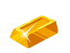
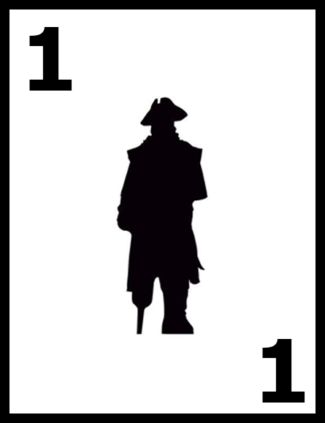
Use case 2.7
Task 10: Visit home port
Final State: A menu appears for the player to deposit their items
3
Venice
Items stored in port
Gold - 1
4
E
2
Confirm
1

Slide 26
Use case 2.8
Task 11: Attack another player
Action: Move Ship onto another ship
Result: Brings up an attack screen
3
N
4
NW
NE
W
E
2
SW
SE
1
S

Slide 27
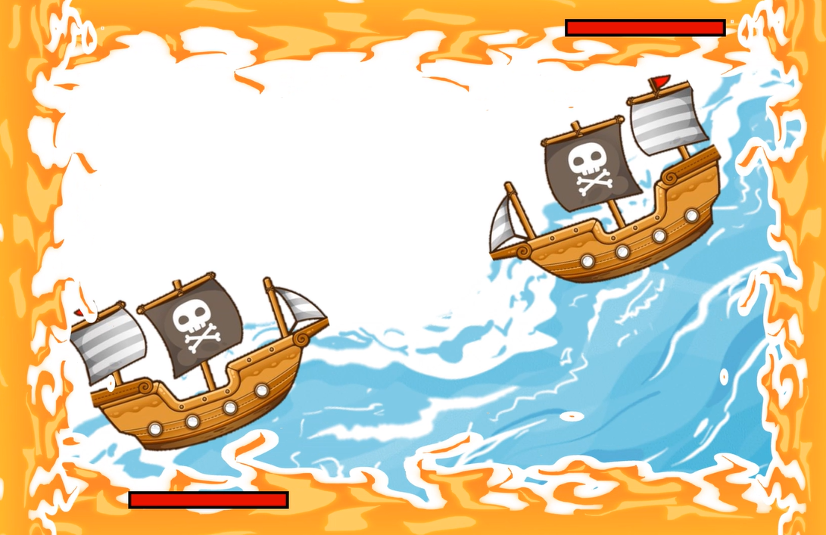
Player 2
Use case 2.8
Task 11: Attack another player
Final State: Brings up attack animation and the player with the higher attack power wins
3
N
4
NW
NE
W
E
1
2
SW
SE
S
Player 1
Player 2 wins the battle!

Slide 28
Use case 2.9
Task 12: Zoom in
Action: Press the plus icon
Result: The screen will zoom in
3
N
4
NW
NE
W
E
2
SW
SE
S
1

Slide 29
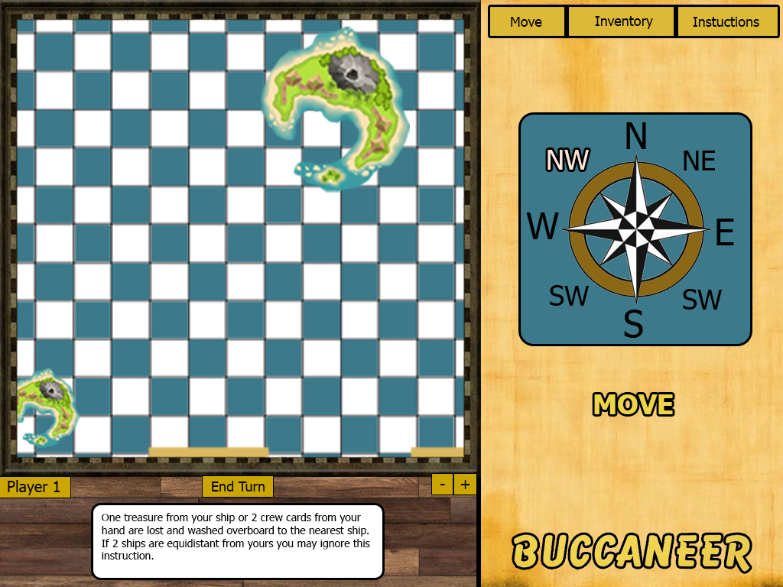
Use case 2.9
Task 12: Zoom in
Final State: The screen is larger around the player
N
2
N
NE
NW
NE
NW
W
W
E
E
SW
SW
SE
SE
S
1
S

Slide 30
Use case 2.10
Task 13: End Turn
Action: Press the end turn button
Result: It will become player 2’s turn
3
N
4
NW
NE
W
E
2
SW
SE
S
1

Slide 31
Use case 2.10
Task 13: End Turn
Final State: The players turn has ended
3
N
N
4
NW
NE
NW
W
W
E
2
SW
SE
SE
S
S
1
Player 2

Slide 32
Use case 2.11
Task 14: Win Game
Action: Get 20 Treasure back to your home port
Result: Win the game
3
N
4
NW
NE
W
E
2
SW
SE
S
1

Slide 33

Use case 2.11
Task 14: Win Game
Final State: Which ever player won has their name displayed for the players to see
3
PLAYER 1 WINS!
N
4
NW
NE
W
E
2
SW
SE
S
1
Play Again
Exit

